Slide 1
Zigzag EPI with Sinusoidal Gradient
Magnetic Resonance Imaging sequence programming
Nan Lan

Slide 2
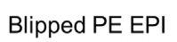


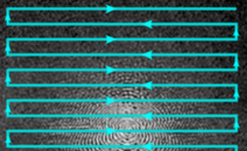
Method—Blipped EPI
Drawback:
noice: round 110-120dB
Reason:
frequent and sharp switch of gradient field
Fig. 1. Blipped Phase Encoding EPI with Sinusoidal Gradient
Source: https://mriquestions.com
Notes:
The standard approach to Echo-Planar Imaging (EPI) is to use trapezoidal frequency gradients with blipped phase-encoding gradients. The noise generated by epi imaging is about 110-120 decibels. This is equivalent to the noise of a rock band. Suffering such long term noice can definitly cause patience‘s unwell and even depression.
Generally speaking, the more frequently the gradient field switches, the greater the vibration of coil, and of course the stronger the noise it generates.

Slide 3
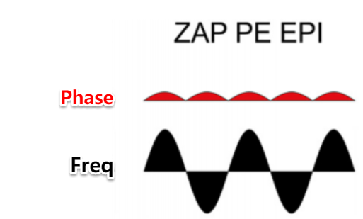
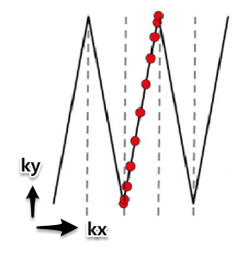
Method—Sin Zigzag EPI
Pros:
quite
Reason:
smooth gradient trajectory due to sin gradient
Fig. 2. Zigzag-Aligned-Projections Phase Encoding EPI with Sinusoidal Gradient [2]
Notes:
To overcome this drawback, the combination of Sinusoidal frequency gradients and Sinusoidal PE gradients is implemented to reduce acoustic noise, which turns out to be ZIGZAG trajetory .
By reducing the switching rate and providing the smoothest possible gradient trajectory, the noise can be significantly reduced, and the noise is smoother and more pleasing. From the pictur we can see the switching is not so sharp as normal EPI.

Slide 4
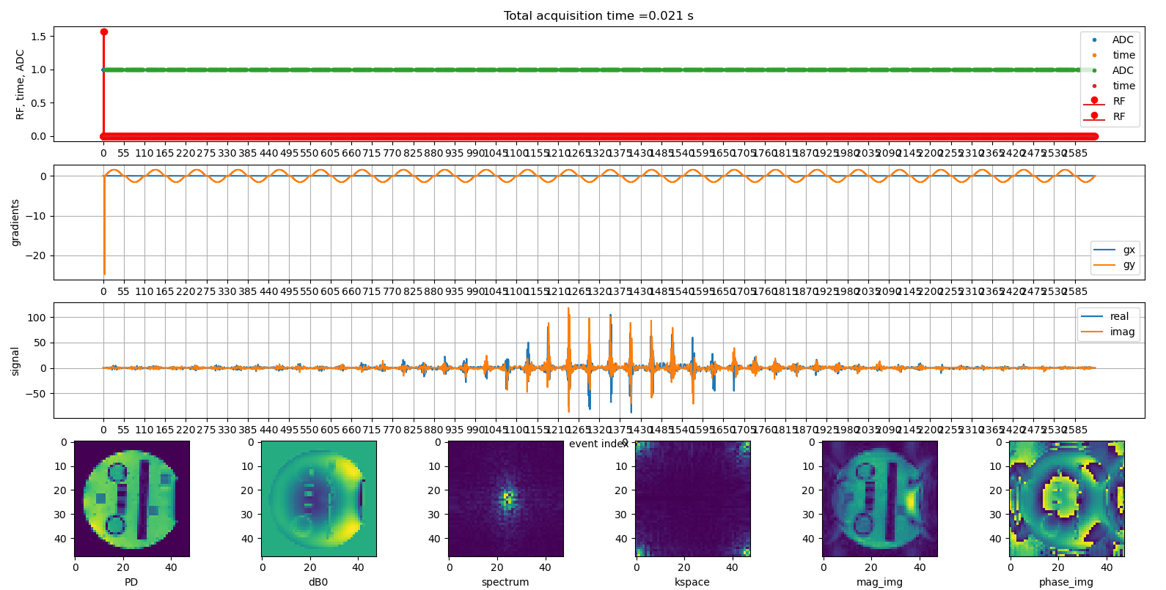

Image Result of Sin Zigzag EPI
Fig. 3.Image Result of Zigzag EPI with Sinusoidal Gradient
Notes:
Here comes the result. Acturally both the orange line and the blue line run as sin function. The change in phase direction(the blue line) is relatively tiny, which makes it look like a straight line.

Slide 5
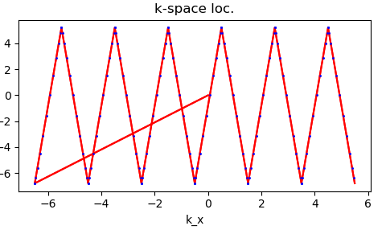
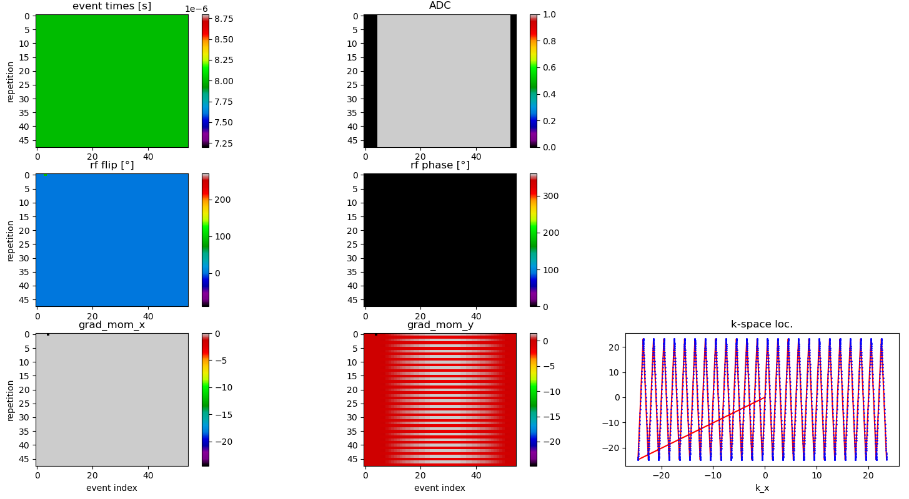
K-space result of Sin Zigzag EPI
Fig. 4.K-space Result of Zigzag EPI with Sinusoidal Gradient
Notes:
From the top right image , we can see that the intervals between ADCs are different. It follow the sin function

Slide 6
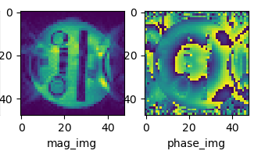
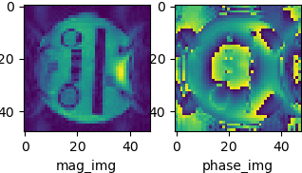
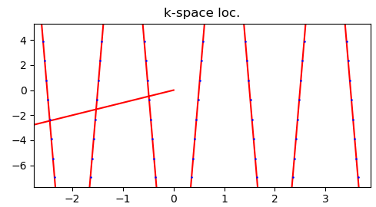
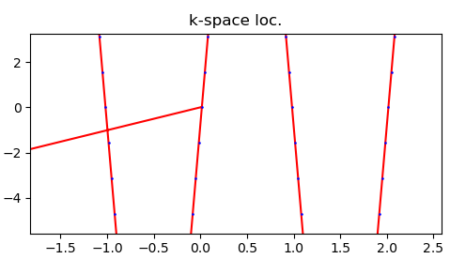
Midpoint correction comparison
Fig. 5. Zigzag EPI with Sinusoidal Gradient without midpoint correction
Fig. 6. Zigzag EPI with Sinusoidal Gradient and midpoint correction
Notes:
Here, I zoom in the kapsce image a bit so that we can clearly see compare them.
After midpoint correction, the reconstruction image becomes better. So we need to adjust the first rewinder in both direction, where the shift can be calculated.
However, this zigzag sequence face challenges for Cartesian parallel imaging techniques. The sequence samples discrete signals sampled at unequal intervals. Therefore, NUFFT is required here.

Slide 7
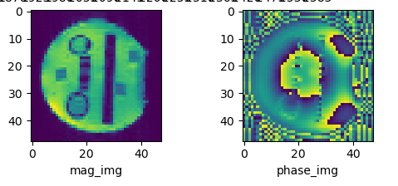
Com. between normal and zigzag sin EPI
Fig. 7. Nnormal EPI without Sinusoidal Gradient
Fig. 6. Zigzag EPI with Sinusoidal Gradient and midpoint correction
Notes:
Now , we compare the reconstruction images bwtween normal and zigzag sin EPI. The reason why the sin EPI gets a worse reconstruction is that it samples much at the boundary of kspace but less in the center
In conclusion, sin EPI Obviously reduces the noise and is very quiet; but it does extend the scanning time to a certain extent. In a word, this is a tradeoff problem within image quality, silence and scanning time.

Slide 8
Referrence
[2] Patrick Liebig, Robin M. Heidemann, Bernhard Hensel & David A. Porter Accelerated silent echo-planar imaging. ELSEVIER 2019. 55: 81–85.

